Slide 1


Quantum Communications Group
Weekly report
Group Coordinator:
Armando Nolasco Pinto
anp@ua.pt
Diogo Matos - 19/10/2023
Group Websites:
https://www.it.pt/Groups/Index/72
LinkedIn: https://www.linkedin.com/company/quantum-communications-group-it-av/

Slide 2
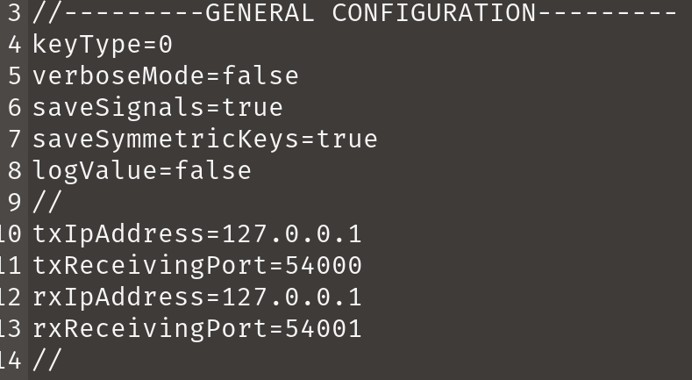
CV QOKD LDPC MULTI-MACHINE - symmetric keys
For each syndrome pair received by the RX, it performs LDPC correction;
Then it compares the syndromes, one or none of them match. There’s no possibility for both of them to match.
If one of them match, RX acknowledges (ack=1), else it does not (ack=0).
When symmetric key generation is activated, a bit is added to the ack message in order to inform TX about which syndrome had a match. Of course, this breaks the obliviousness property.
SM1 | SM2 | ACK
0 | 0 | 0
0 | 1 | 1
1 | 0 | 1
Oblivious ACK
SM1 | SM2 | ACK
0 | 0 | 00
0 | 1 | 11
1 | 0 | 10
Symmetric ACK

Slide 3
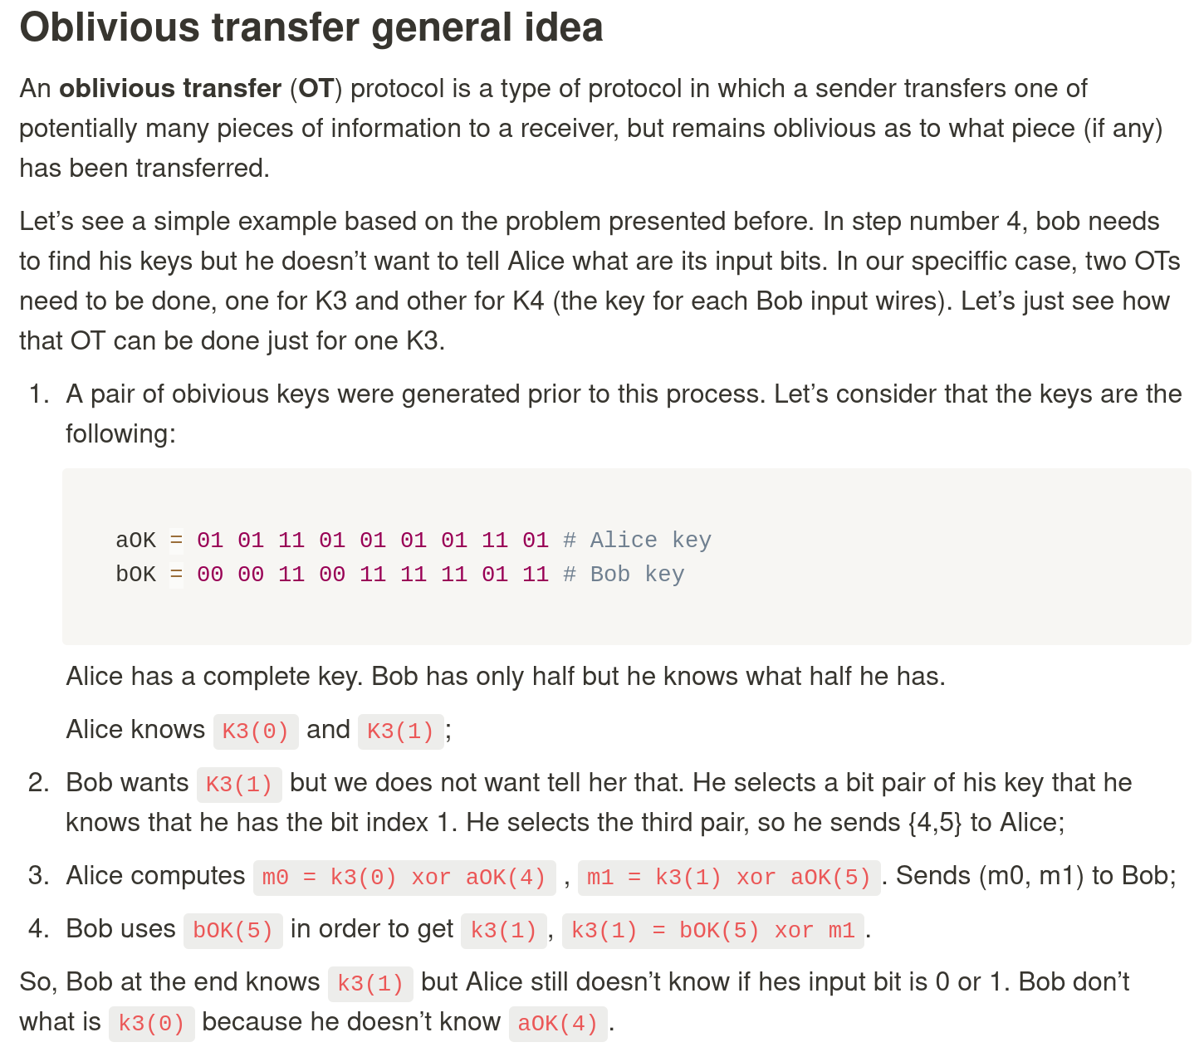
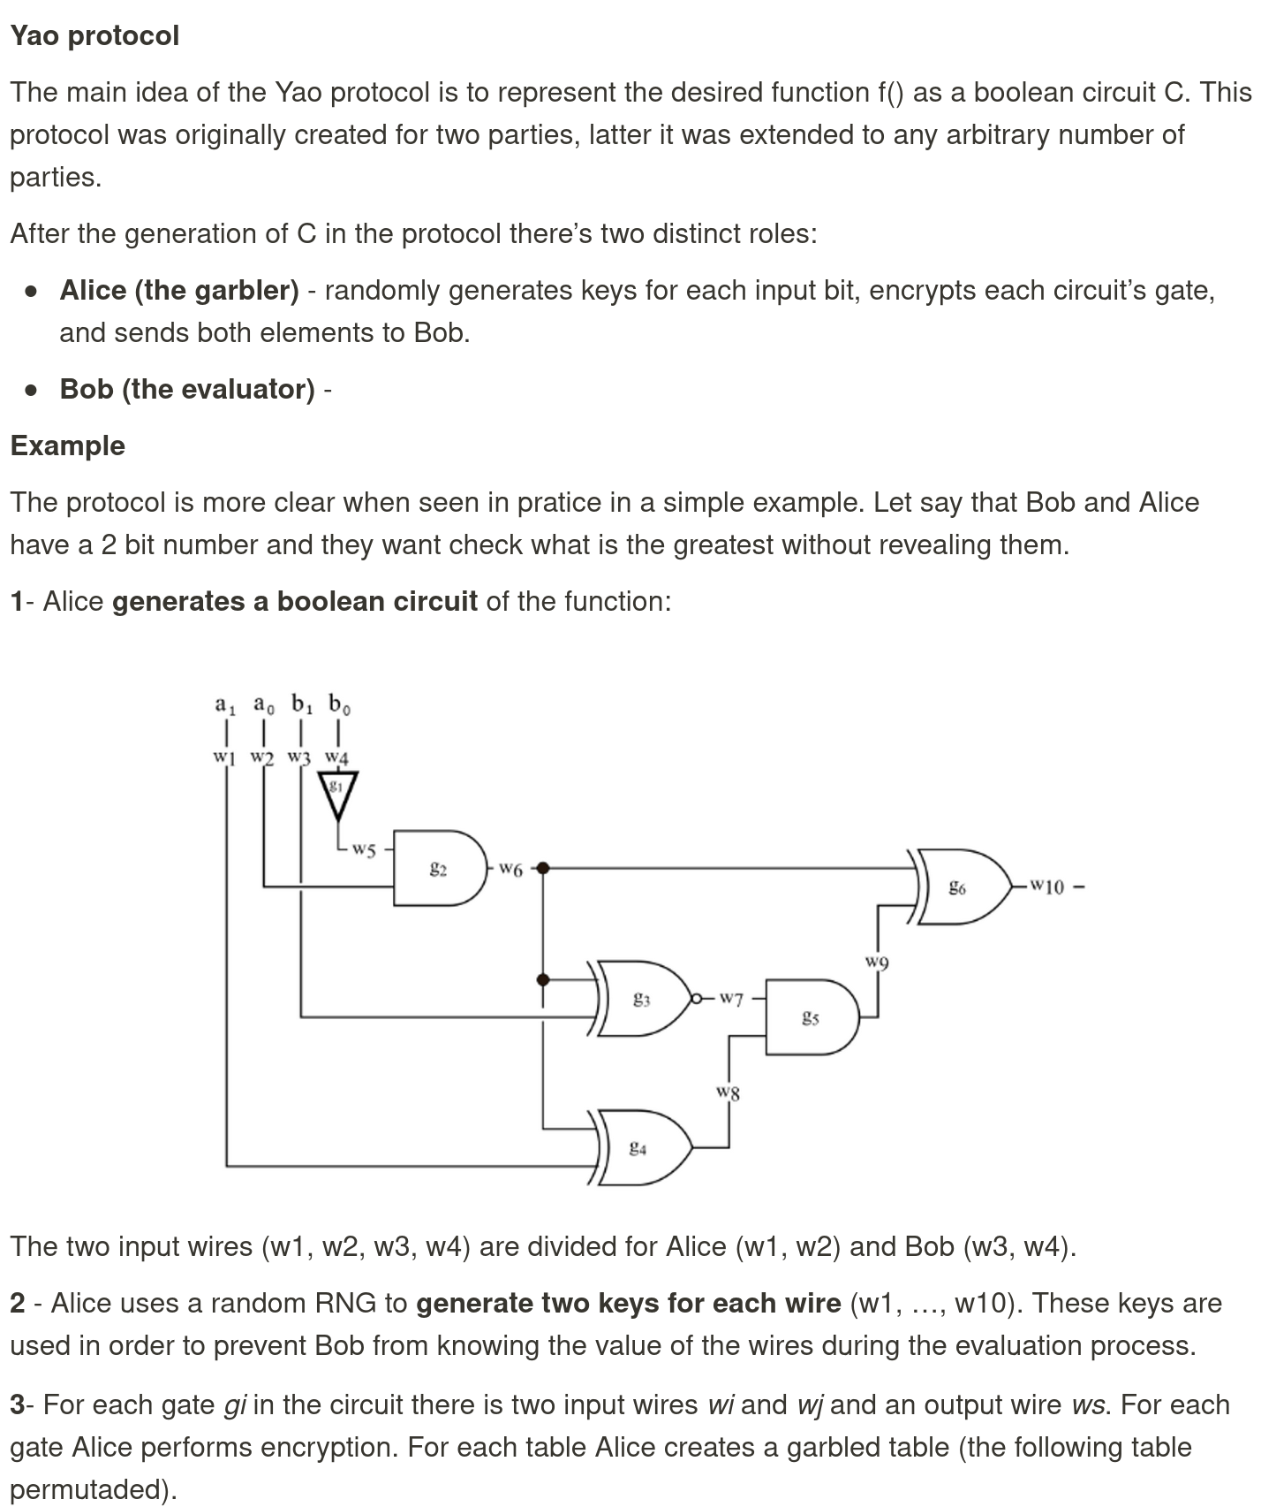
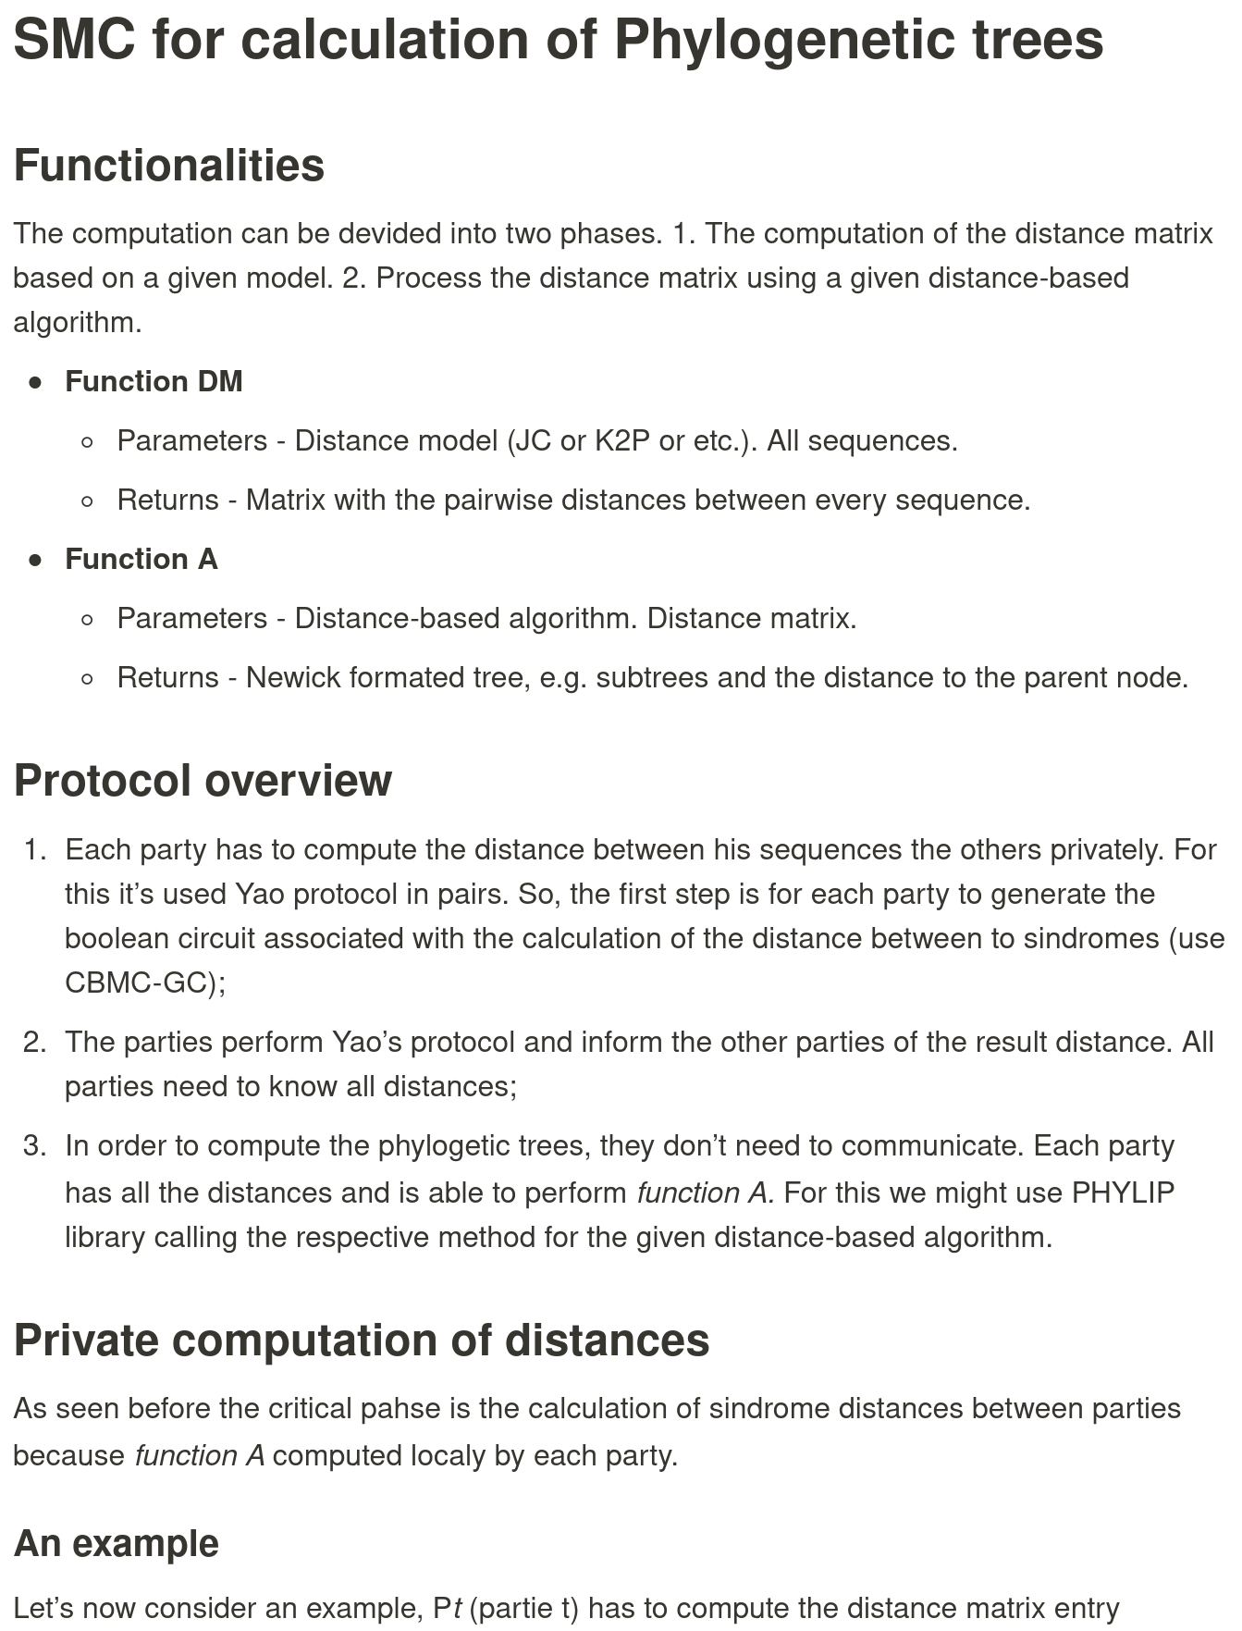
SMC
Access notes here

